Slide 1


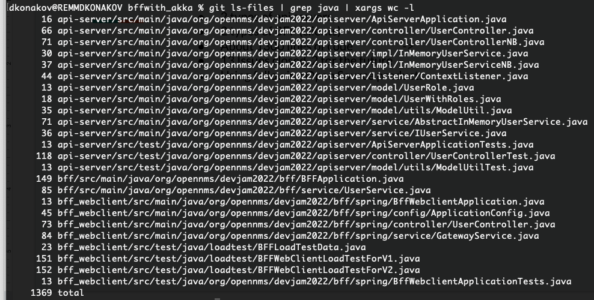

Little bit information about the project
2 types of API servers
2 types of BFF (clients)
About 1300 lines of code
13 Issues closed, 2 for the future
Using following Open Source products
Notes:
Little bit about the project in nutshell (what we have done in 4 days)

Slide 2
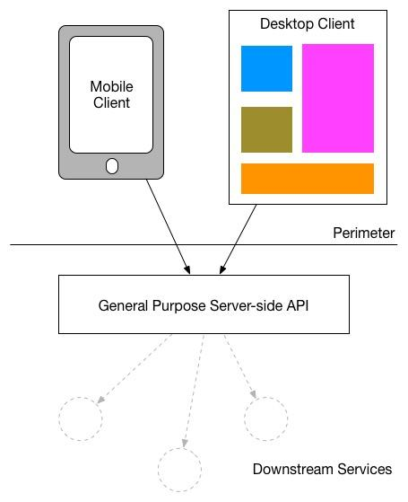
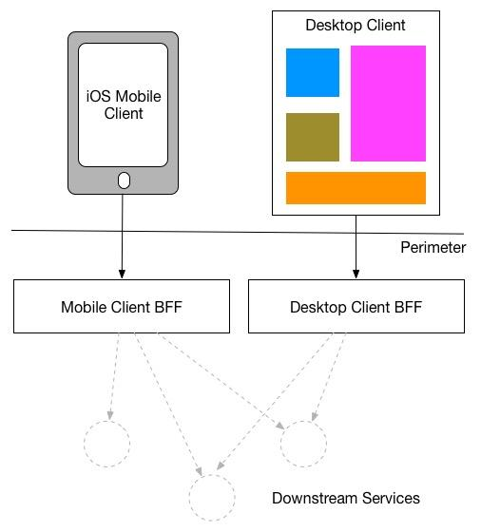

General Idea of BFF
From
To
More here: https://samnewman.io/patterns/architectural/bff/

Slide 3
And now about our architecture… seriously…
getUserList only
Simple SpringBoot based LT
V1
AKKA based BFF
Simple REST API
InMem
[HashT]
SpringBoot
“Reactive” REST API
JMeter based LT
WebClient based BFF
V2
getUserList
getUserById
addUser

Slide 4
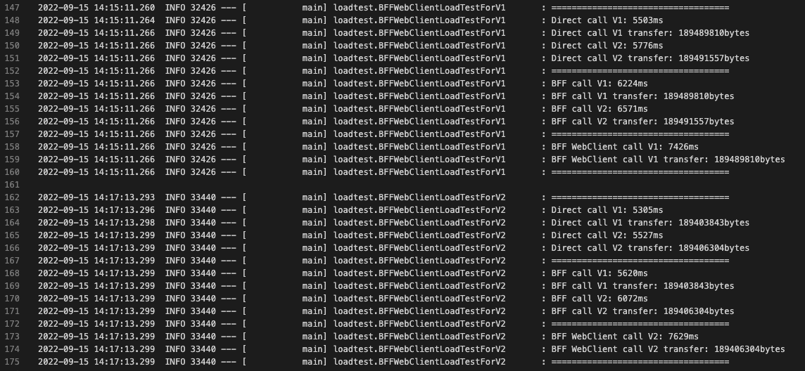
Results (Simple LT)

Slide 5


